Slide 1
SLIIT students’ attitudes and preferences regarding Online Shopping!

Slide 2
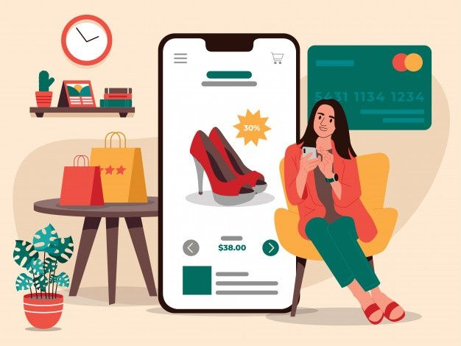
INTRODUCTION
We are First Year Second Semester students of Faculty of Computing at SLIIT,
We have conducted a survey to understand the SLIIT students’ Online Shopping behavior.

Slide 3
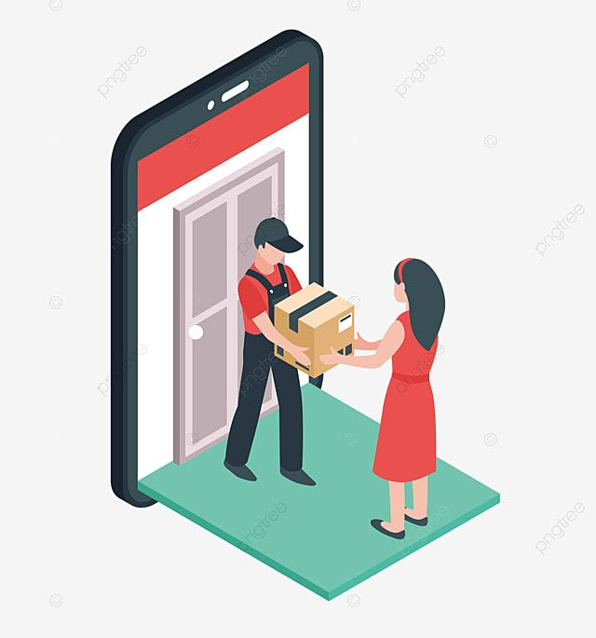

OBJECTIVES
At the end of this presentation we expect,
To inform about key findings of our survey.
Help to understand online Shopping behavior.
Provide insights into online selling behavior.
To address security concerns.

Slide 4


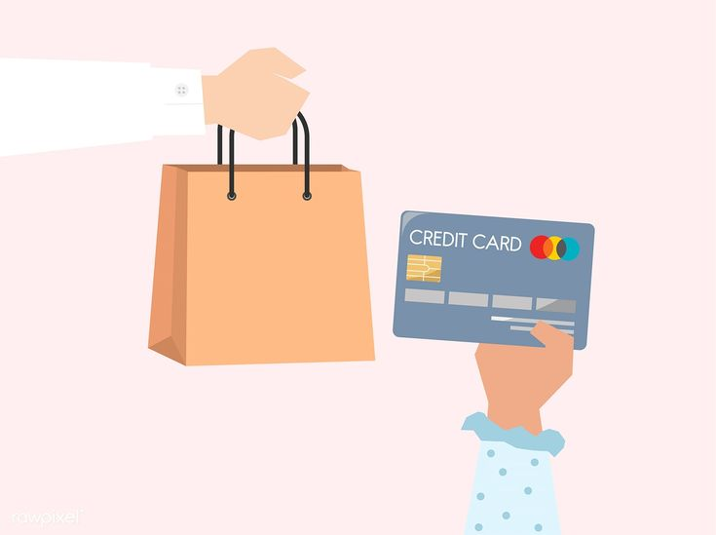
METHODOLOGY
The survey consisted of 20 questions and was administered online.
The survey was distributed to students of different faculties in SLIIT.
Data collection took over about 2 weeks and a total of 100 students participated in the survey.

Slide 5
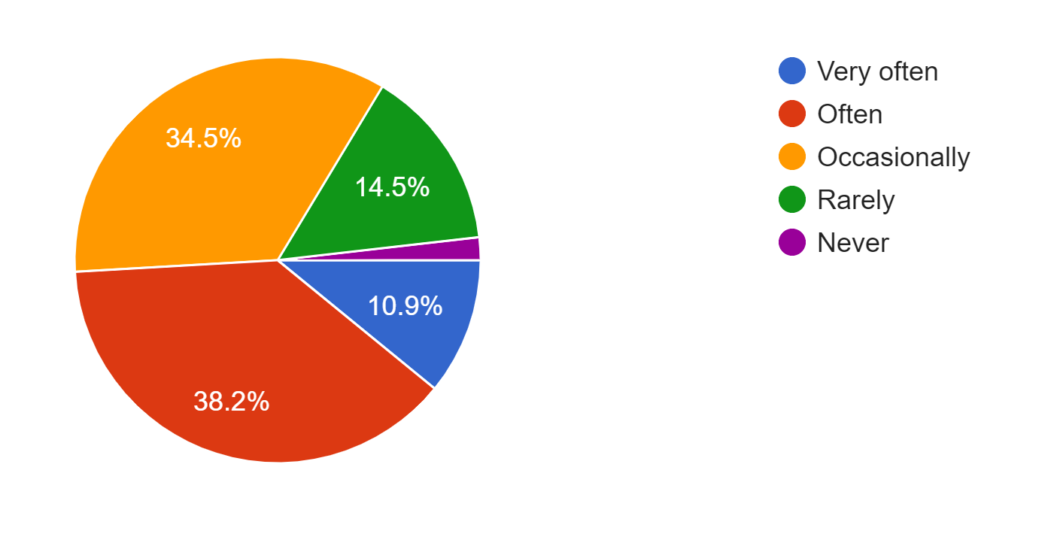
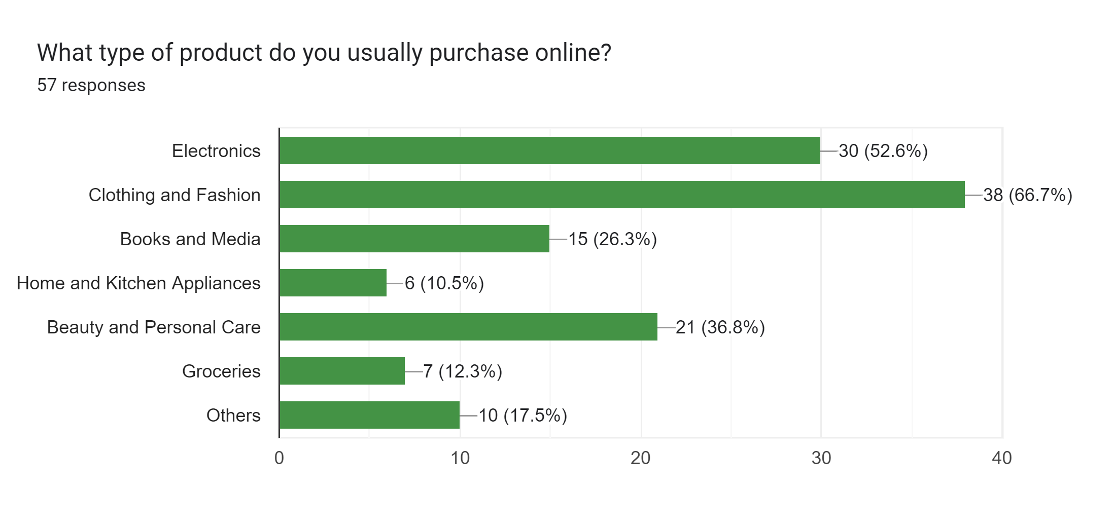

ONLINE SHOPPING BEHAVIOR
Products!
How often!

Slide 6
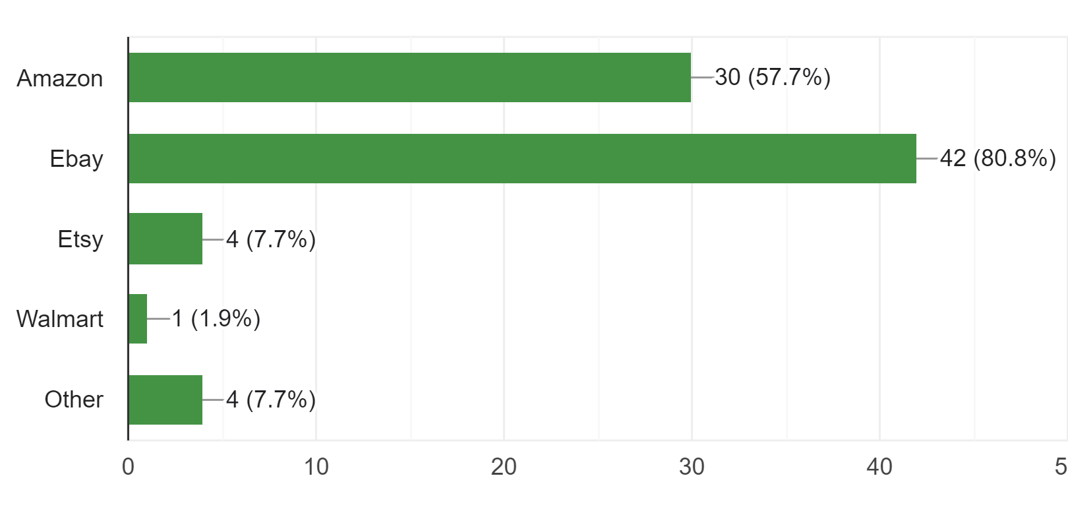
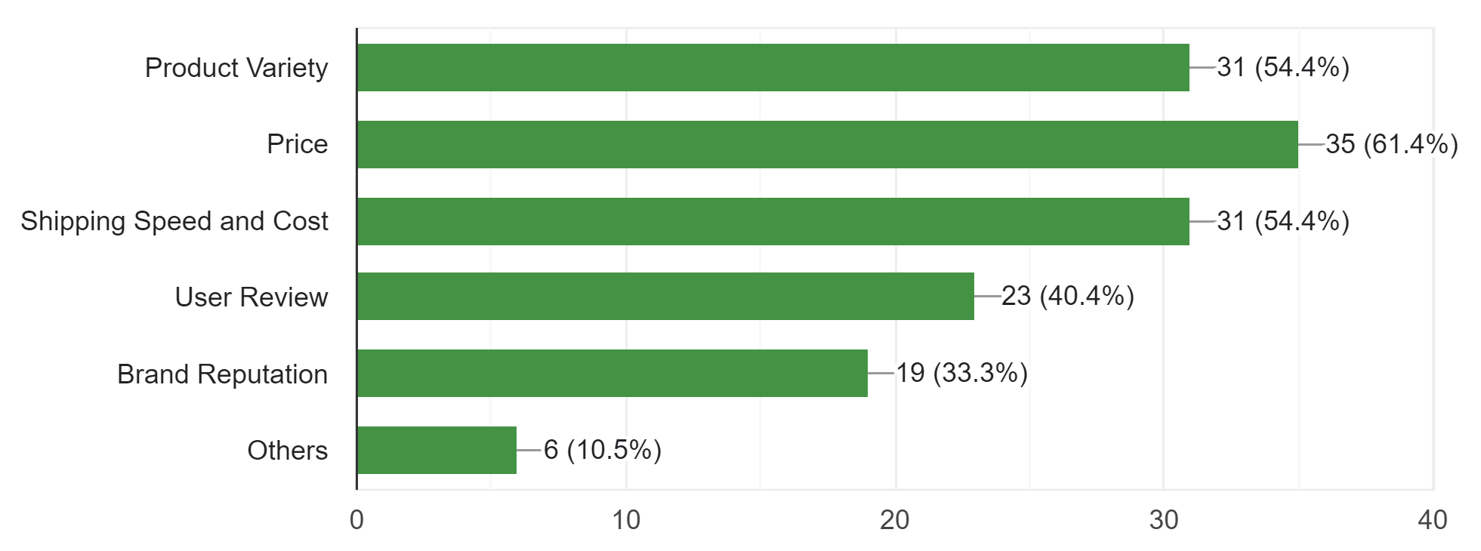


Online Platforms
Factors of choice!

Slide 7
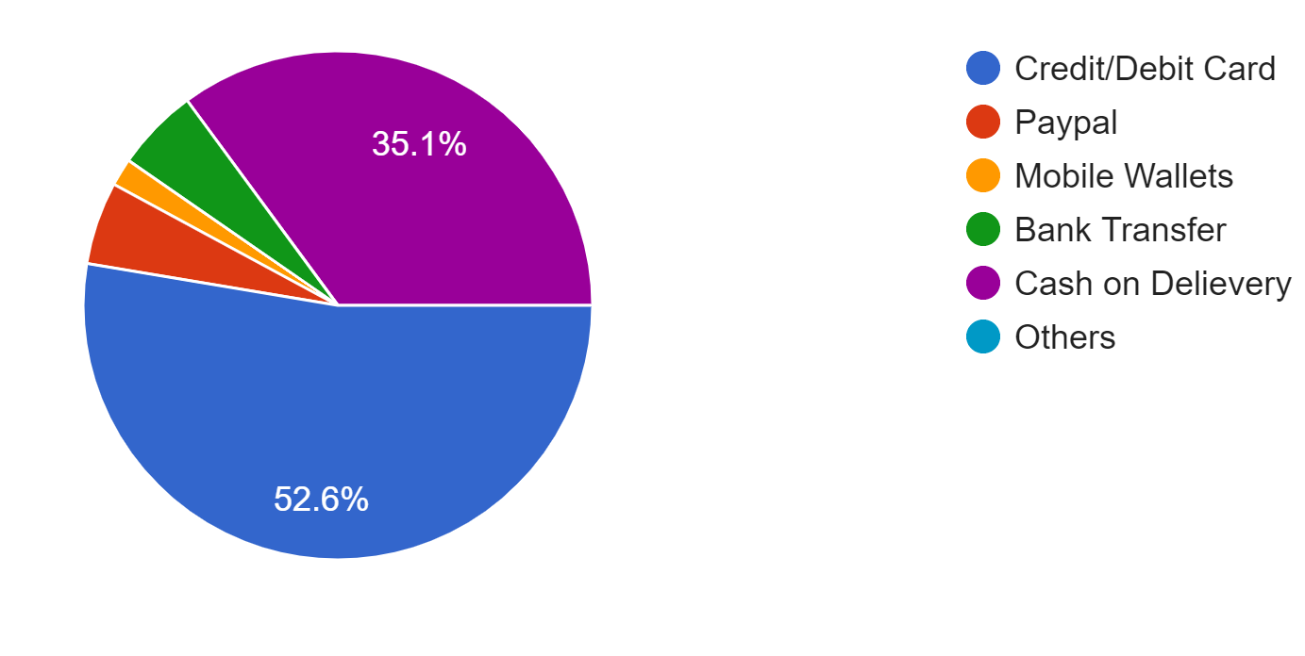
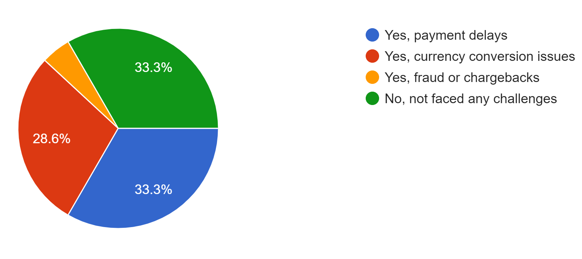
Payment Methods
Challenges

Slide 8
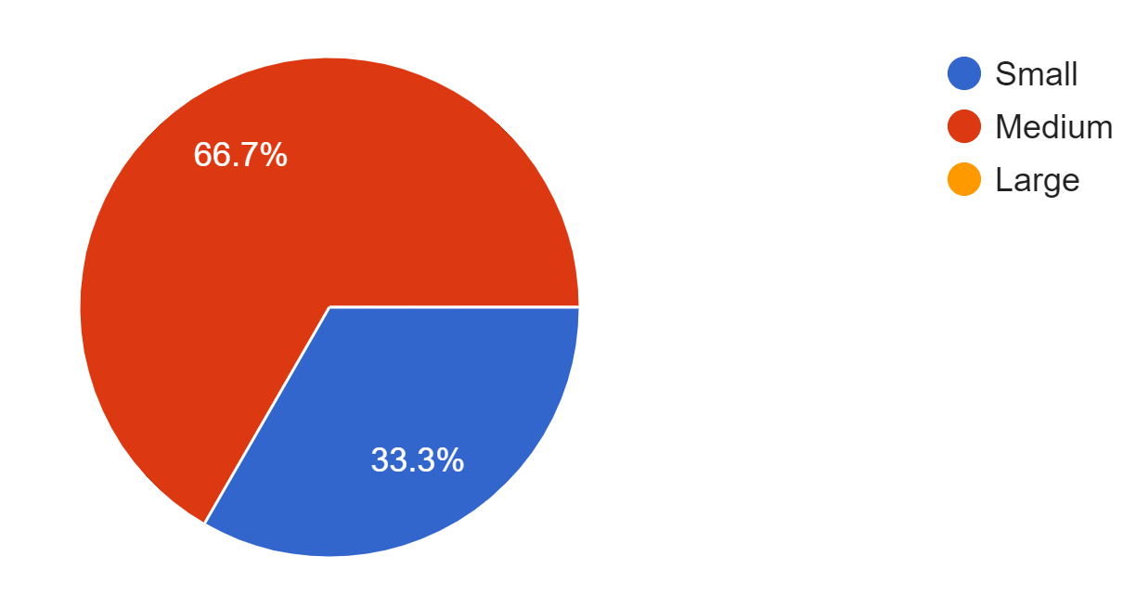
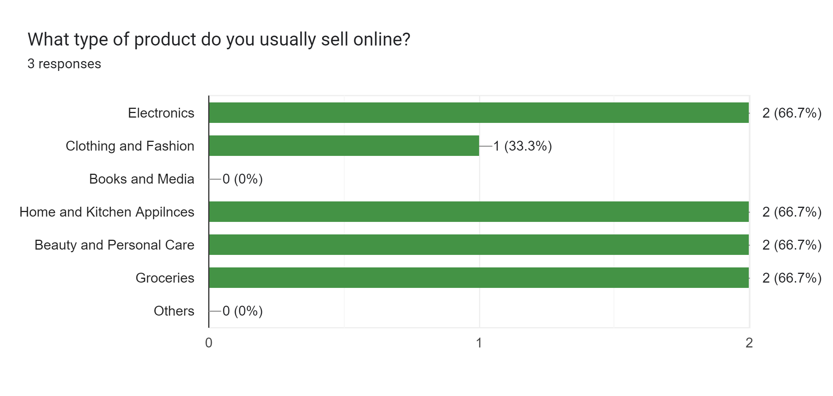
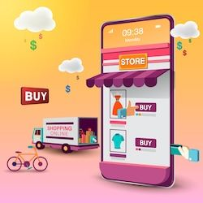
ONLINE SELLING BEHAVIOR
Size!
Products!

Slide 9
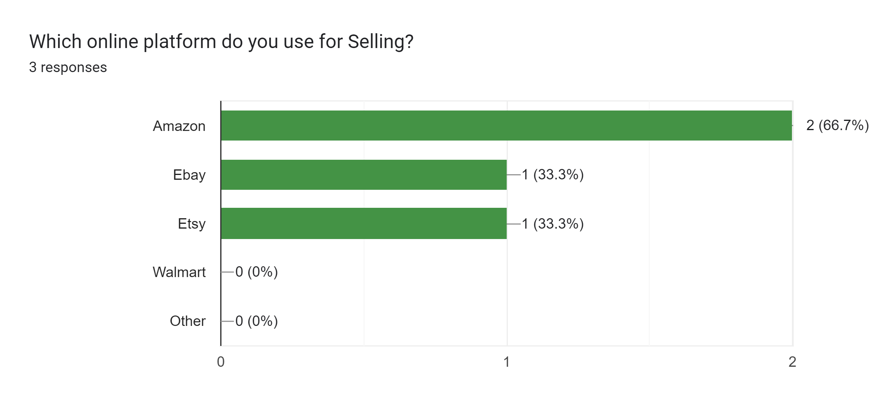
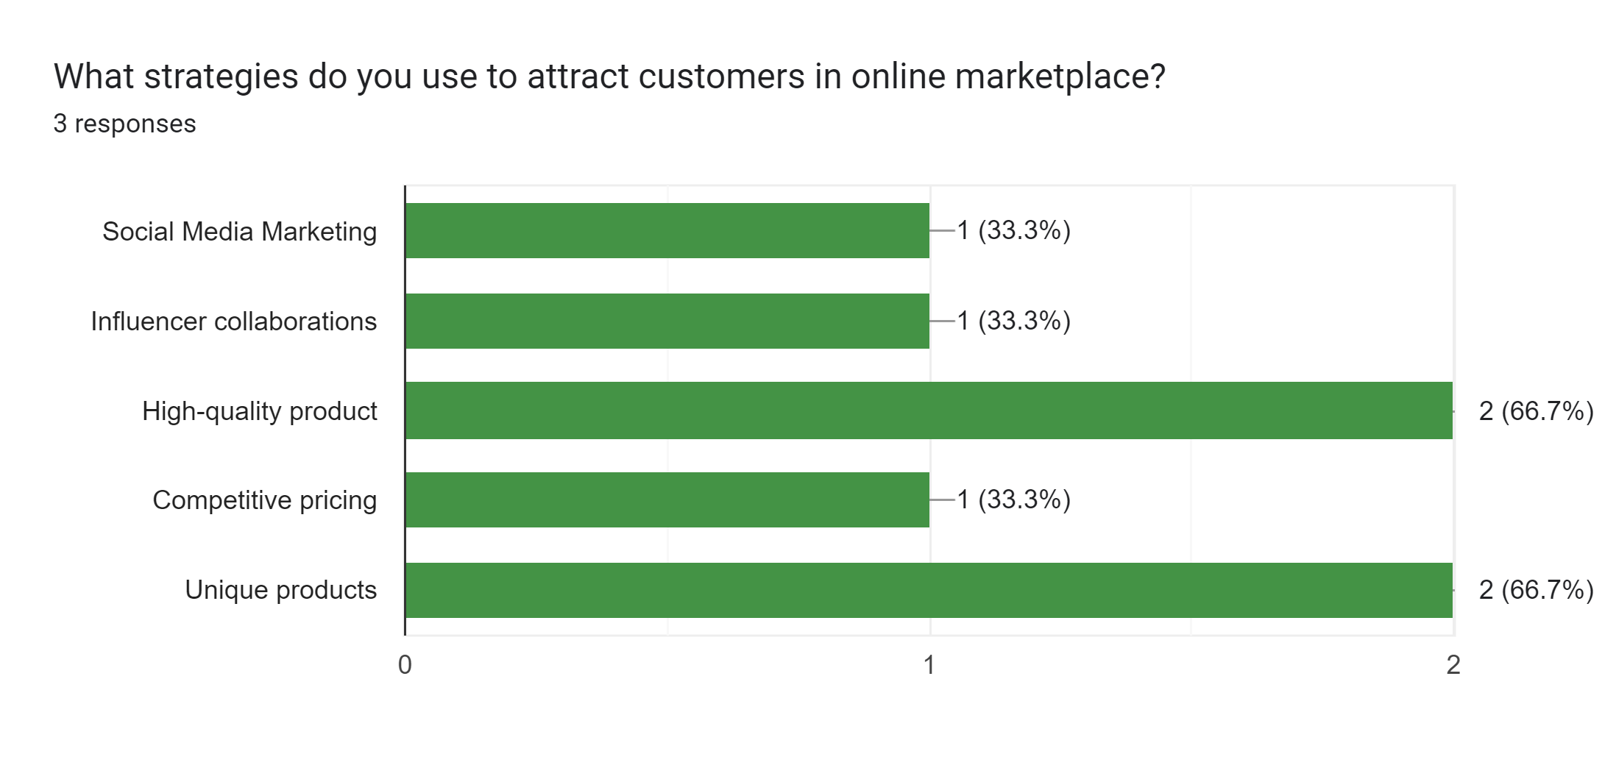

Platforms!
Attractive strategies!

Slide 10
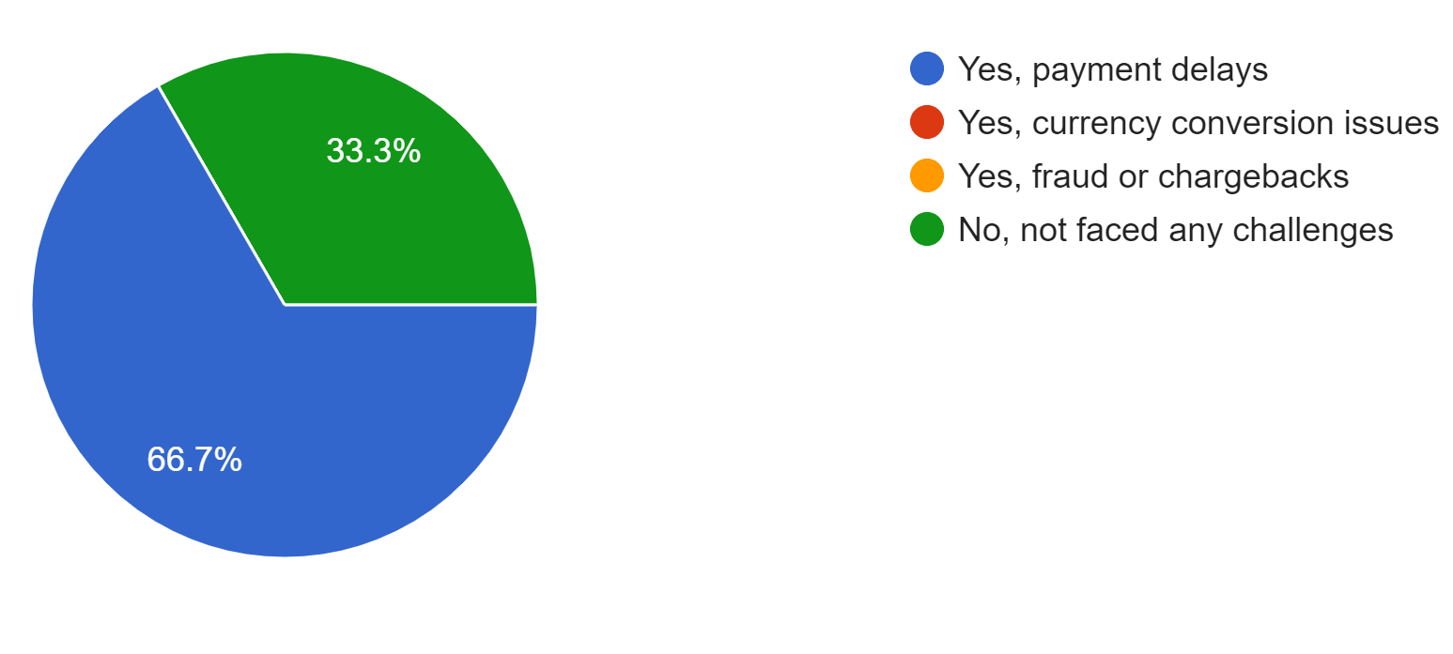
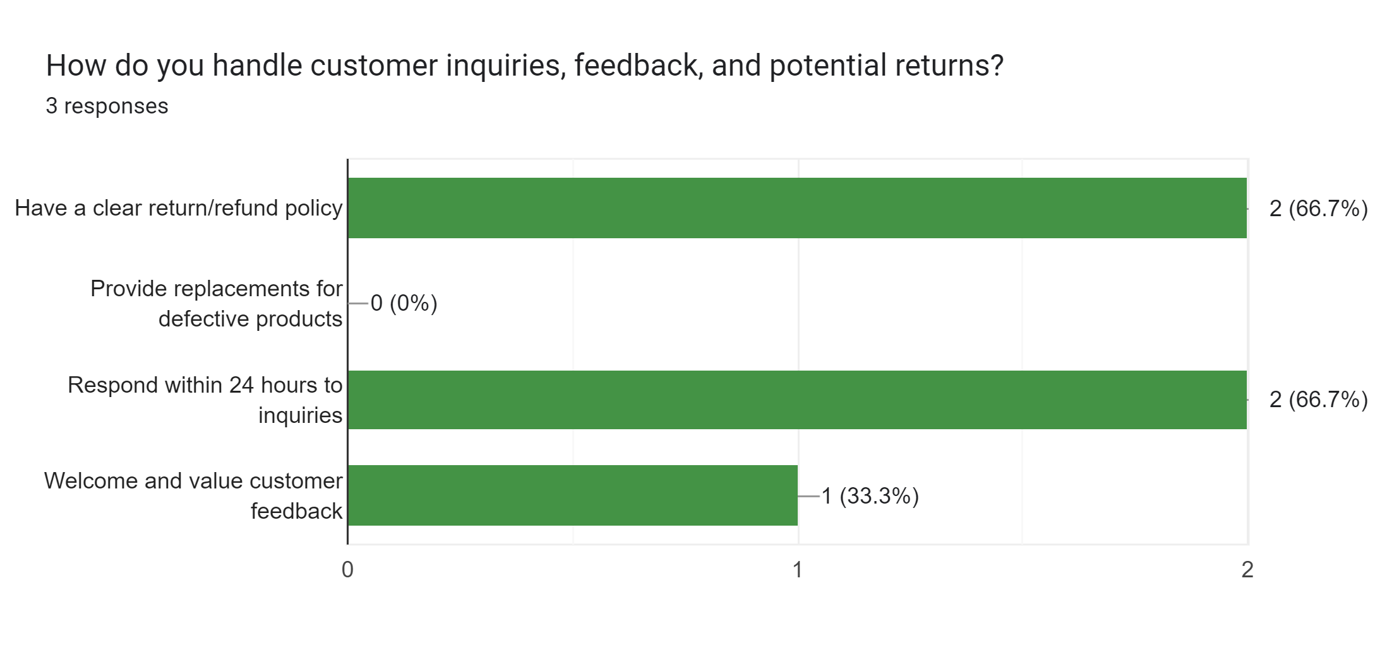


Challenges!
Handling Customers!

Slide 11
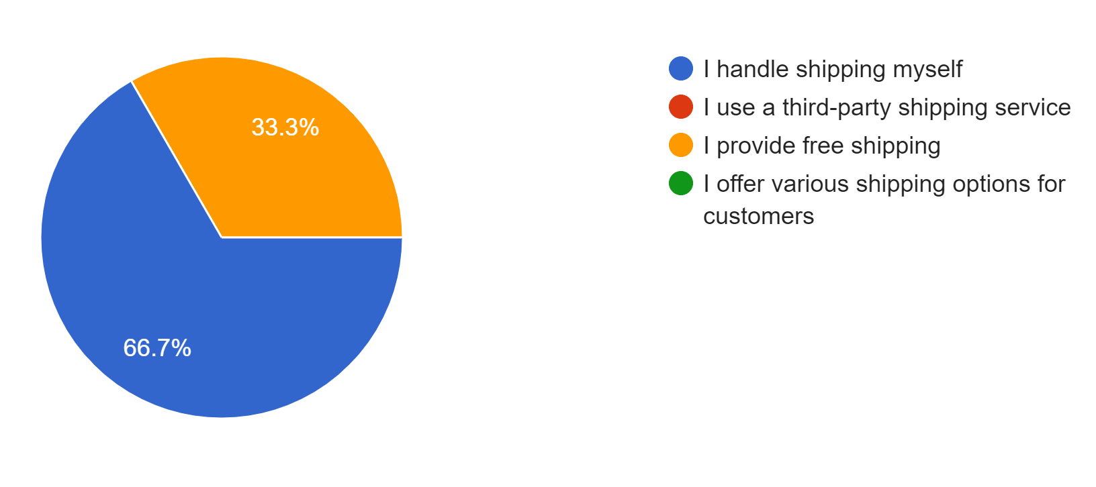
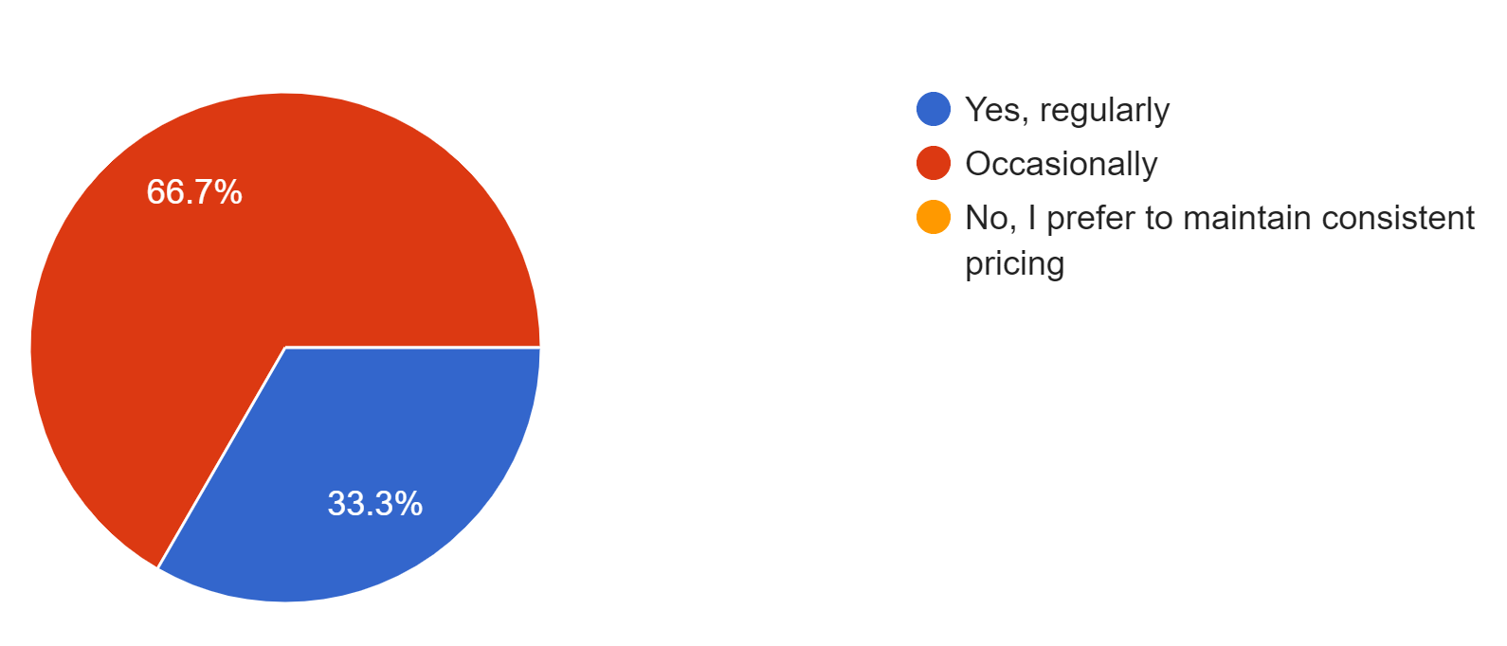
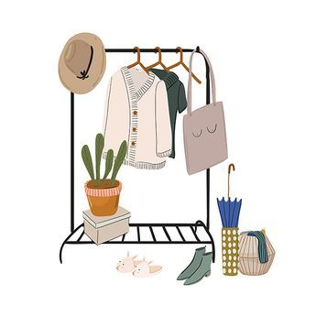

Shipping and Delivery!
Promotions and Discounts!

Slide 12
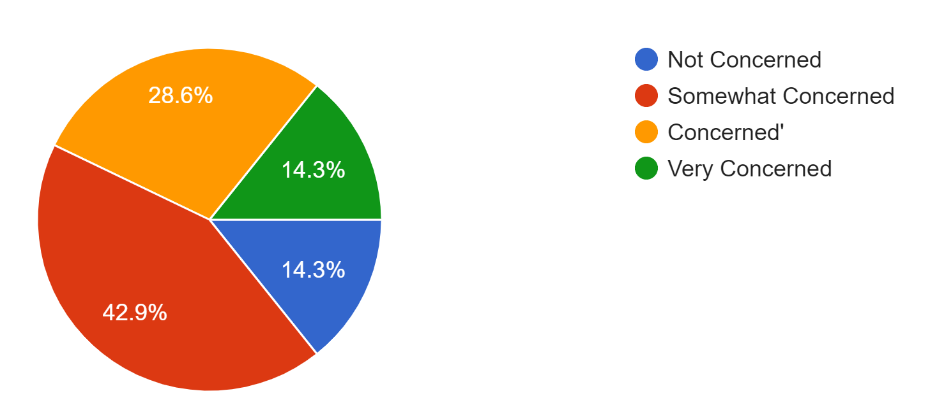
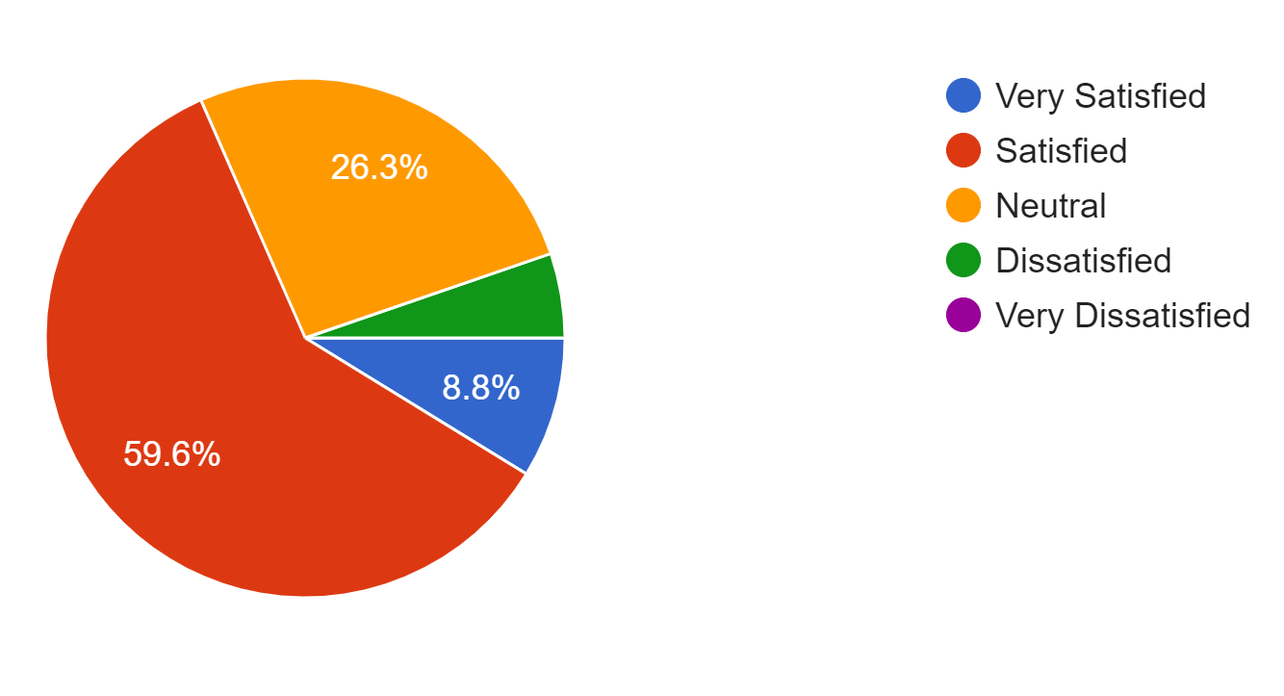


SECURITY & SATISFACTION
Personal Security!
Online shopping Experience!

Slide 13

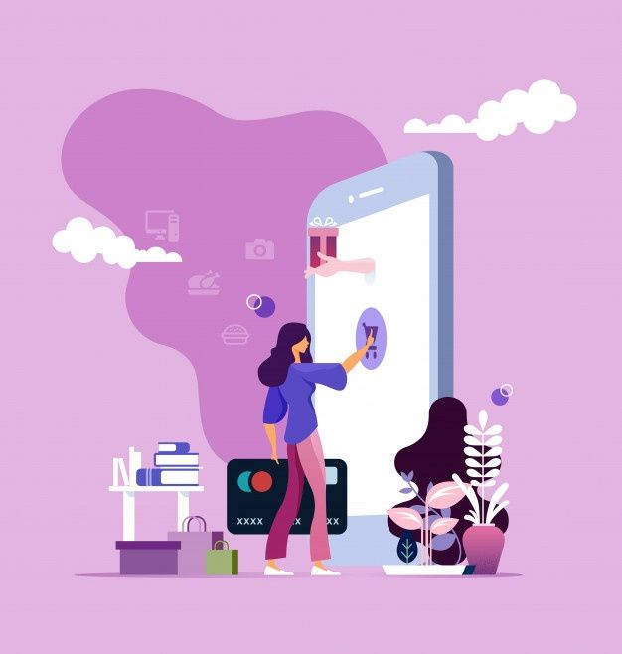
SUGGESTIONS & IMPROVEMENTS
Improving access to online shopping resources.
Implementation of additional security protocols.
Educating students on safe online practices.
Introduction of new payment methods.
Simplifying the payment process for students.

Slide 14


OVERALL TRENDS
Most of the students purchase “Clothing and Fashion” and most preferred platform is “eBay”.
Most common payment method is “Credit and Debit Cards”.
Most of the students are concerned about their security when shopping.
Majority of sellers handle their own shipping and delivery.
Most of selling businesses are “Medium” in size.
“Delays in payments” is the popular challenge here.

Slide 15
OUR TEAM!
IT Number | Name
IT22253958 | W.P.R. Nethmina
IT22296078 | Sarithmal K.D
IT22226532 | D.V.D Hashan
IT22635952 | Abeywickrama A.S.
IT22244352 | Hewahalpage
IT22371522 | G.H.P Iroshan

Slide 16

THANK YOU!
Thank You everyone for Listening!
Have a Nice Day!

